Slide 1

Find the Best Neighborhood in NYC To Settle in During and After the Pandemic

Slide 2
Deciding which neighborhood to move to
Generally, people check the commute distance and near by places to visit while deciding which neighborhood they want to move
But these priorities have changed during this pandemic
Everyone wants to see which neighborhood is better equipped to handle mass hospitalization during this pandemic
So having this information will help people in their decision

Slide 3
Data acquisition and cleaning
New York City data that contains borough, neighborhoods along with their latitudes and longitudes. o Data source: NYC data set
Get population data from Scraping Wikipedia.Data source:Wikipedia page of NYC neighborhood
Hospital information is going to be fetched from foursquare API
Hospital bed information is going to be fetched from NYS Health Profile website. Data source:NYS Health Profile
The final data frame is normalized

Slide 4
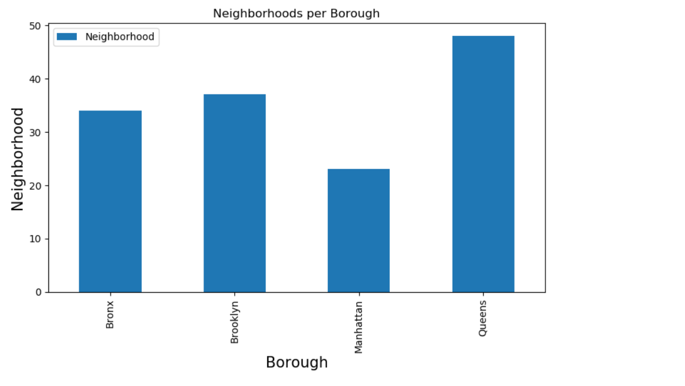
Box plot per borough and neighborhood

Slide 5
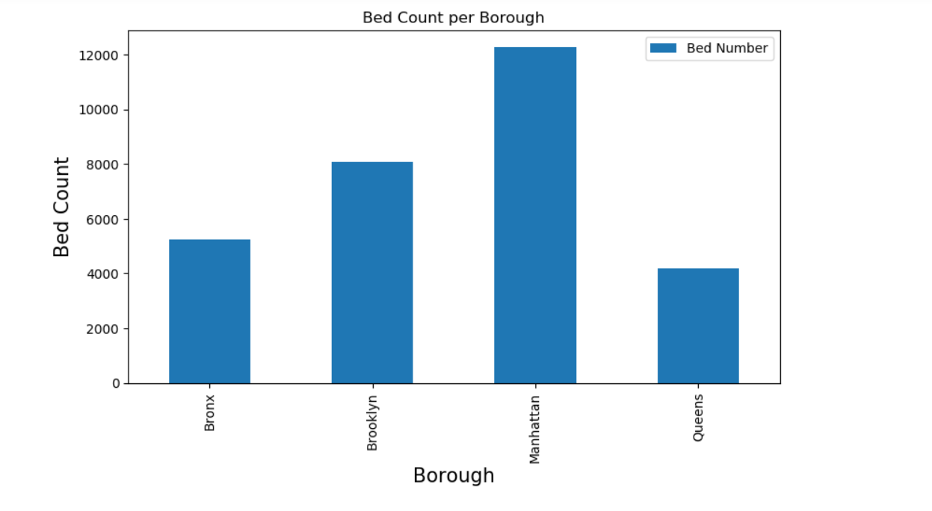
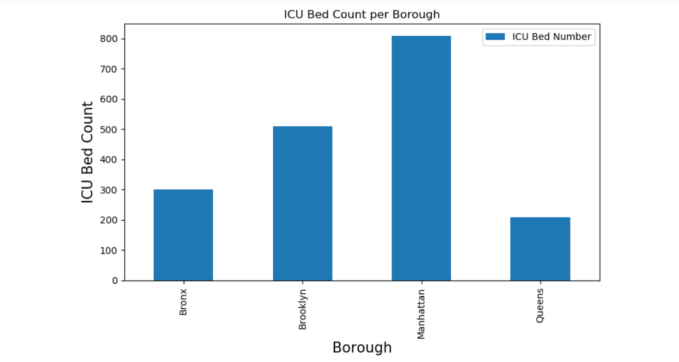
Regular Bed count and ICU Bed Count Per Borough

Slide 6
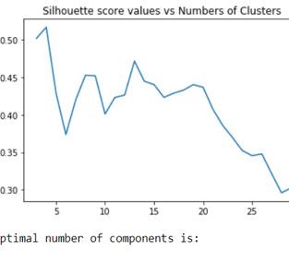
Scatter Plot for Optimal number of Clusters using K-means clustering

Slide 7
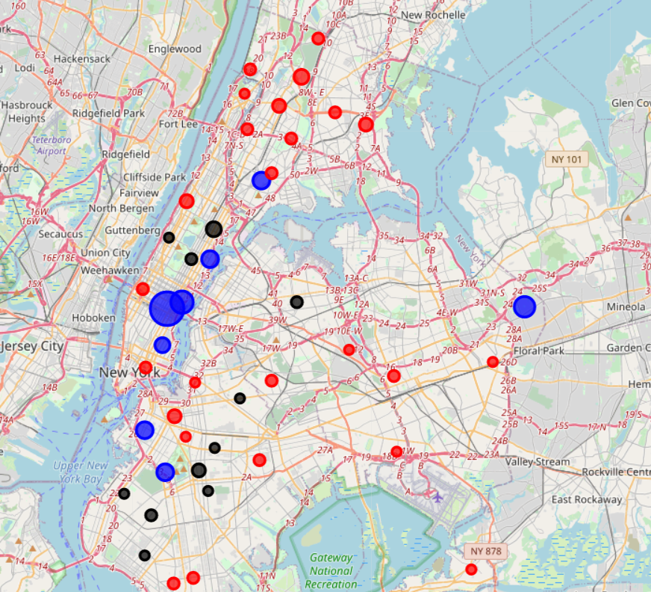
Folium Visualization For Beds per 100 People

Slide 8
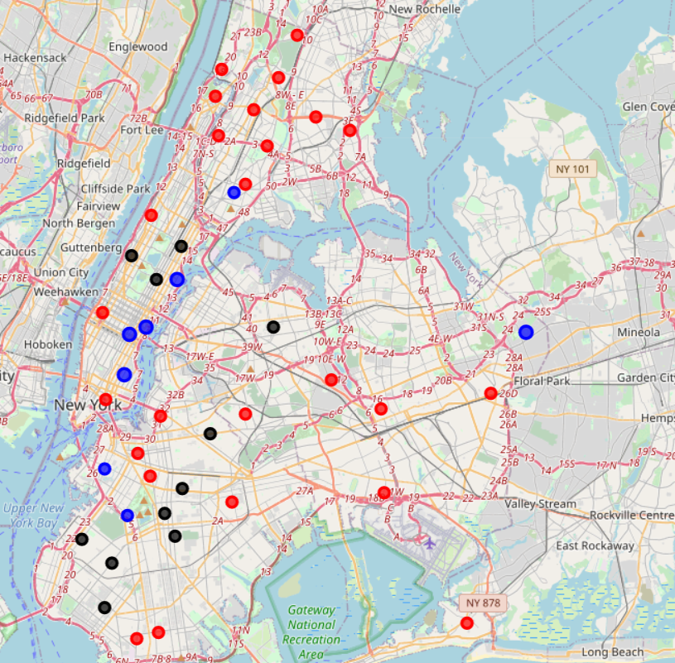
Folium Visualization For ICU Beds per 100 People

Slide 9
Conlcusion
Successfully built K-means model to identify most well equipped hospitals in NYC
During the analysis, several important statistical features of the boroughs/neighborhoods were explored and visualized
Manhattan-East Harlem was chosen as the most well equipped(as per hospital bed count and ICU bed count) area to battle pandemic

